Slide 1
Introduction to Machine Learning
(SUPERVISED LEARNING)

Slide 2
Types of Machine Learning
Supervised Learning
Data + labels
E.g. Classification, Regression
Un-Supervised Learning
Data
E.g. Clustering , Dimensionality Reduction

Slide 3
Supervised Learning
A dataset is provided with n data points and corresponding labels
{(X₁, y₁) (X₂, y₂), ……, (X_{n}, y_{n})}
The goal here is to find a function , f which can give an ouput for an new example: f(y|X)

Slide 4
Supervised Learning Pipeline
Training
Supervised ML Algorithm
Training Data
Feature Engineering
Evaluate Classifier on Validation Data
Labels
Is accuracy achieved or Best Model
Change the config of feature generation and model parameters
No
Yes
Prediction
Final Classification Model
Feature Engineering
Class label and Score
Test Example

Slide 5
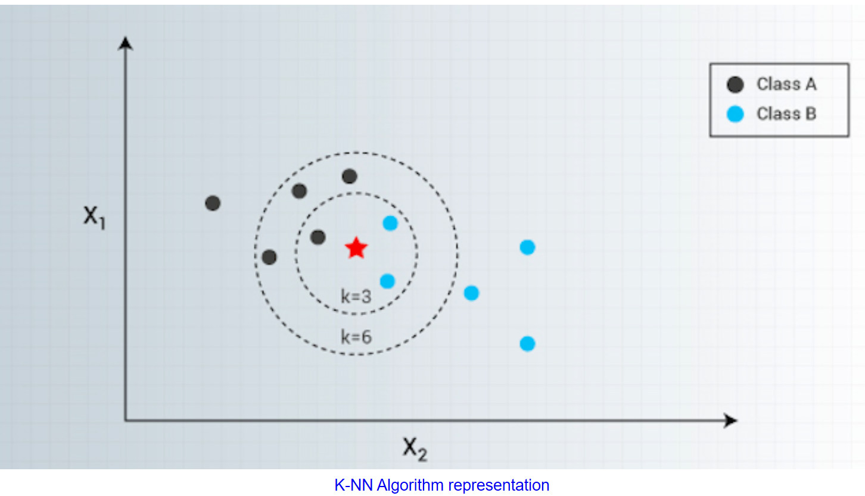
k-NN
K-Nearest Neighbors is one of the most famous classification algorithms
It’s simple and accurate.
It’s there in statistics world for quite some years under non-parametric techniques.
Assumption: Similar things exists in proximity!

Slide 6
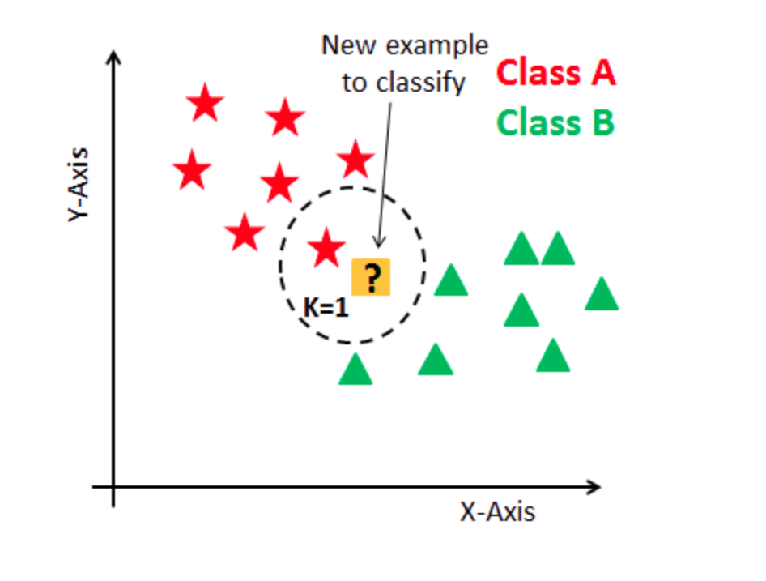
How k-NN works
Given: {Data, class labels}
What’s the label for new data point?
Steps:
Calculate distance
Find closest neighbors
Vote for labels (Max Rule)

Slide 7
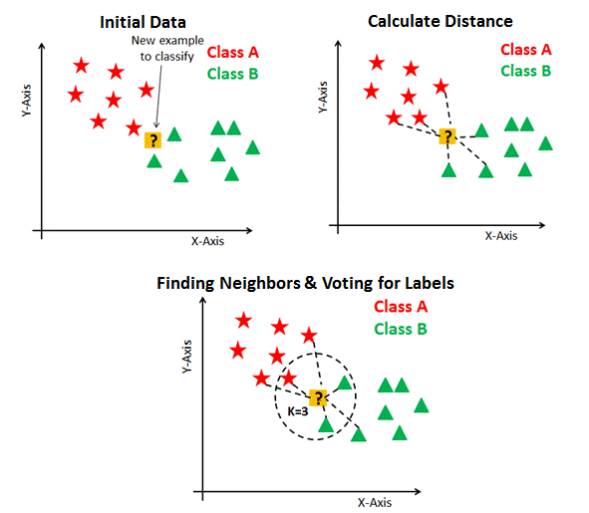
How k-NN works

Slide 8
Tuning k value
k is a controlling variable for the prediction model.
A large k value is more precise as it reduces the overall noise !
Range: 1 and ~10% of training data set size!
Cross-validation : Use an independent dataset to validate the k value.
Generally, an odd number is chosen if the number of classes is even.

Slide 9

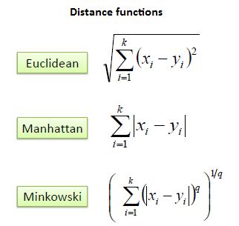
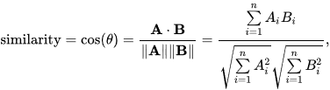
Distance Function

Slide 10

Evaluation Metric
C11 | C12 | C13
C21 | C22 | C23
C31 | C32 | C33
True label
Predicted label

Slide 11
Memory & Runtime
Storing the complete training data. So, the memory needs grow linearly with the number of data points you provide for training
All calculations happen during model inference. Hence, the scoring runtime scales linearly with the number of data columns and the number of training points.
Very suitable for off-line tasks.

Slide 12
k-NN
Advantages:
k-NN is a simple but effective classification procedure
Applies to multi-class classification
Decision surfaces are non-linear
Quality of predictions automatically improves with more training data
Only a single parameter, K. easily tuned by cross-validation
Disadvantages:
May not scale well with the increase in data dimension (curse of dimensionality!)

Slide 13
Hands-on
Iris dataset
Digit classification

Slide 14
Unsupervised Learning

Slide 15
Clustering
Requires data, but no labels
Detect patterns
Group emails or search results
Customer shopping patterns
Regions of images
Useful when don’t know what you’re looking for
Basic idea: group together similar instances

Slide 16
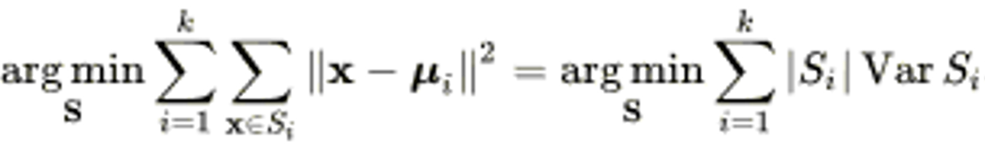
K-Means
Given a set of examples (x₁, x₂, …, x_{n}), where each examples is a d-dimensional real vector
K-means clustering aims to partition the n observations into k (≤ n) sets S = {S₁, S₂, …, S_{k}} so as to minimize the within-cluster sum of squares (WCSS)
Minimize the WCSS (inter) and maximize (intra) BCSS (between-cluster sum of squares)

Slide 17
K-Means
An iterative clustering algorithm
Initialize: Pick K random points as cluster centers
Alternate:
Assign data points to closest cluster center
Change the cluster center to the average of its assigned points
Stop when no pointsʼ assignments change

Slide 18
K-Means (4)

Slide 19
Evaluation Methods
Clustering analysis doesn’t have a solid evaluation metric, as there is no ground truth data.
Most popular evaluation methods:
Elbow method
Silhouette analysis

Slide 20
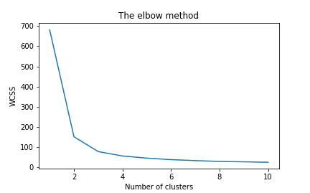
Elbow method
Helps us to find what a good k bee based on the sum of squared distance (SSE) between data points and their assigned clusters’ centroids.

Slide 21

Silhouette analysis

Slide 22
K-Means
Advantages
Easy to use
Need to know K
May need to scale data
Good initial method
Local optima
No guarantee of optimal solution
Repeat with different starting values

Slide 23
Hands-on
Iris dataset
Digit dataset

